Slide 1

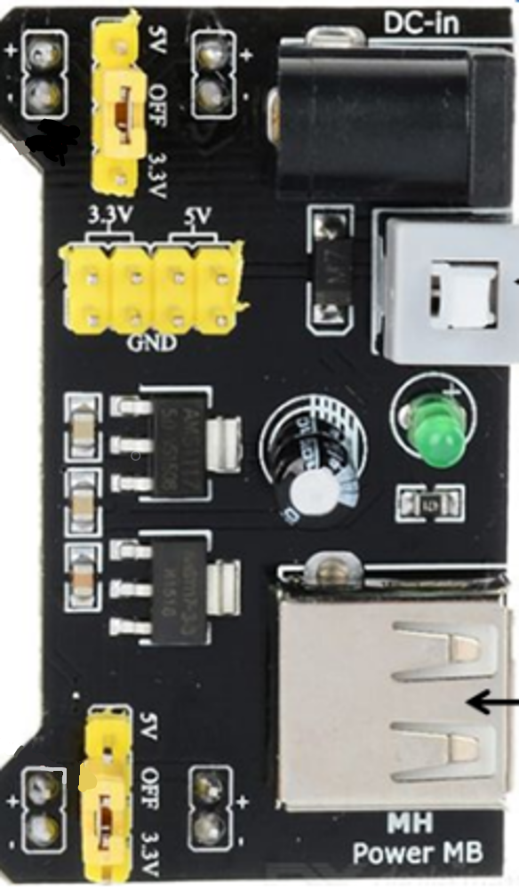
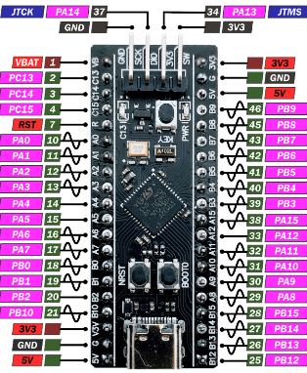
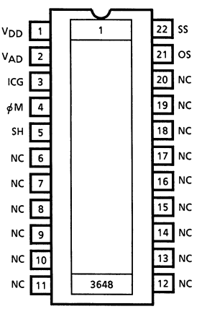
Power Supply ->
HC-05 ->
9
10
11
12
RX
TX
VCC
GND
3
7
8
5
CCD
6
4
2
<- STM32
1

